Slide 1
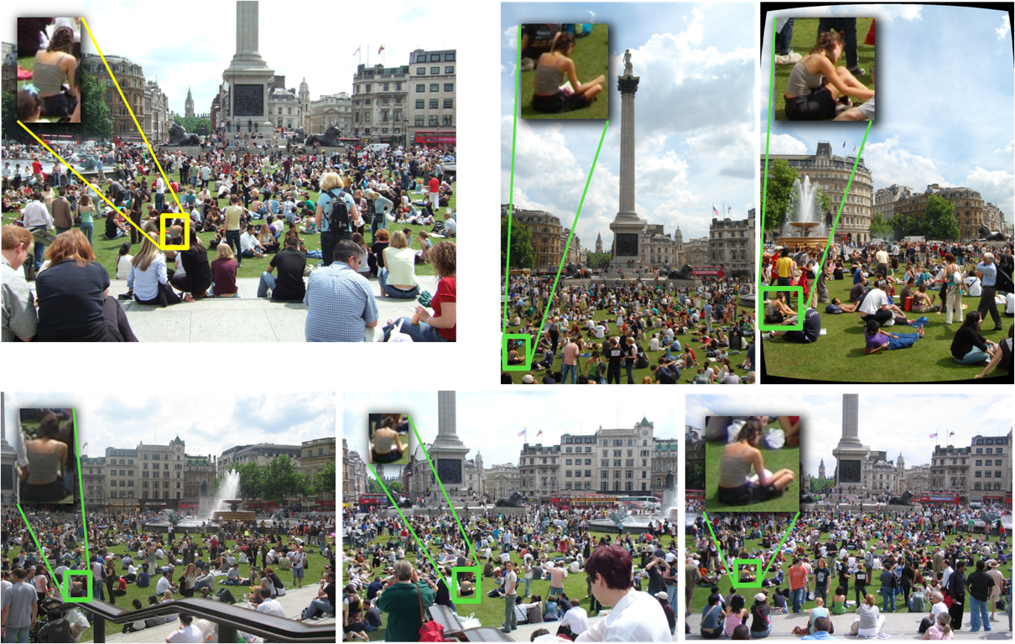
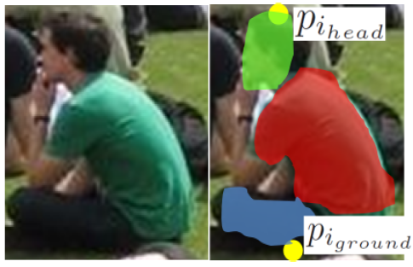
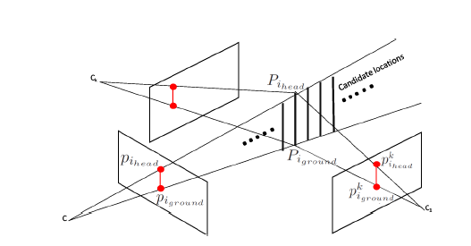
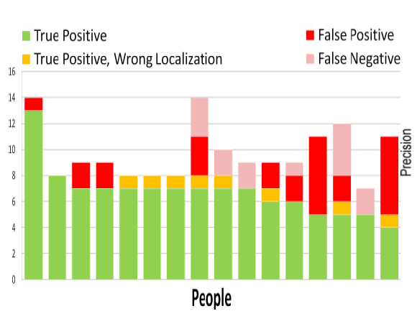
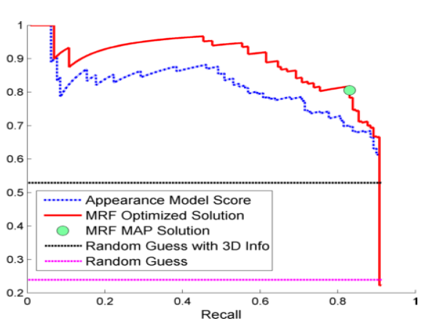
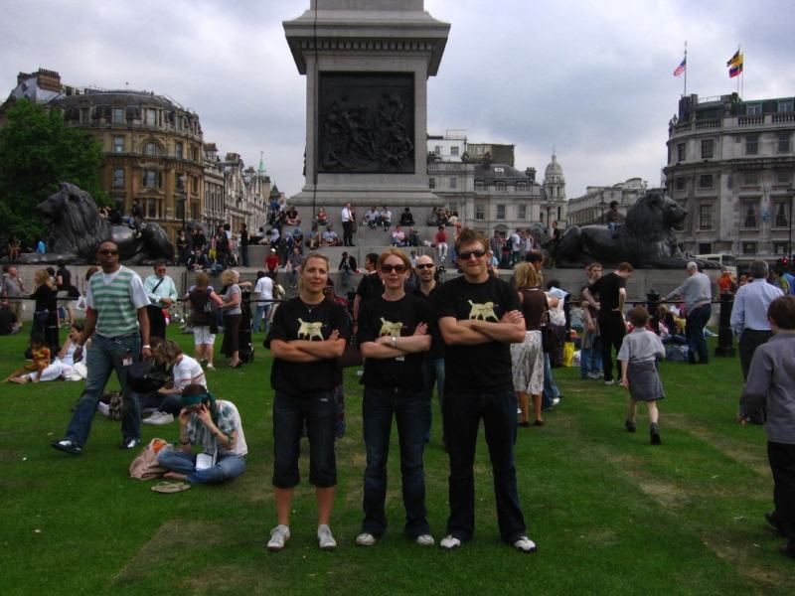
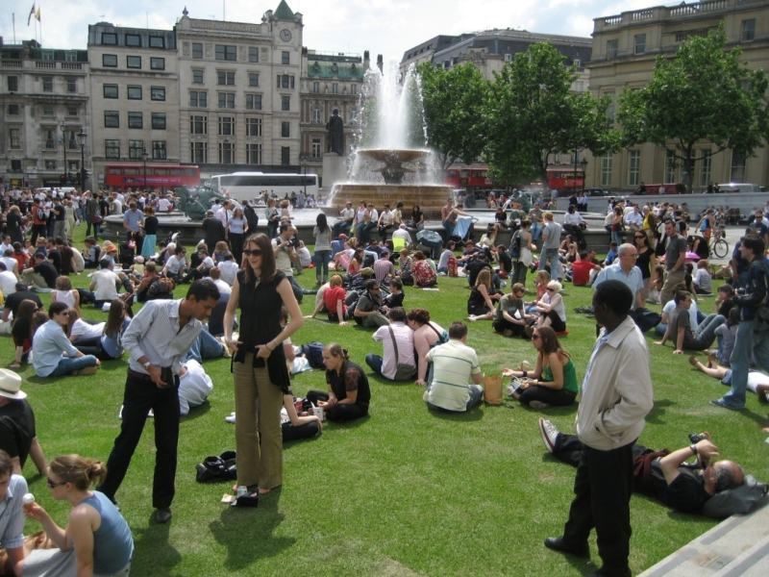
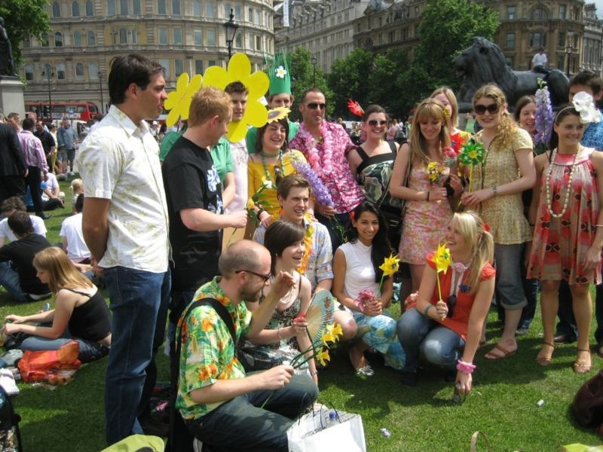
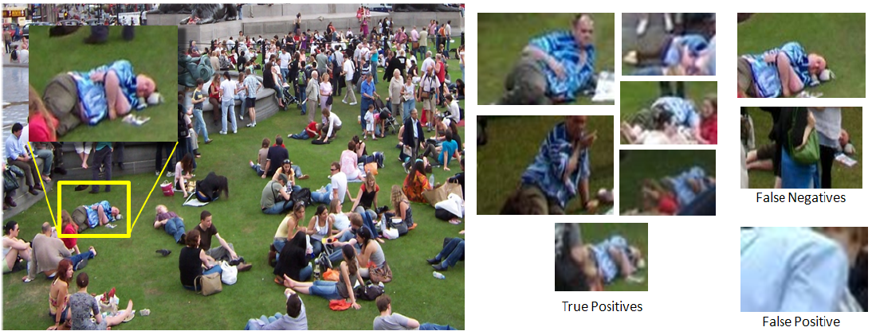
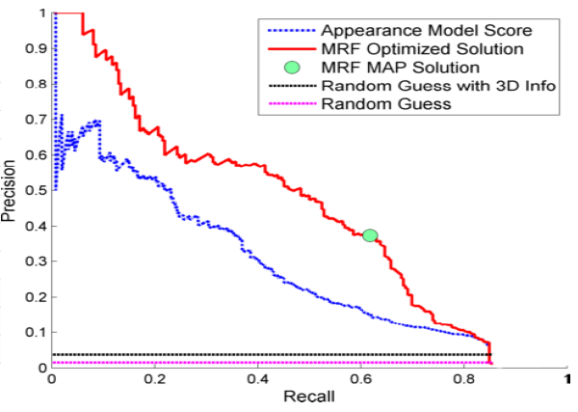
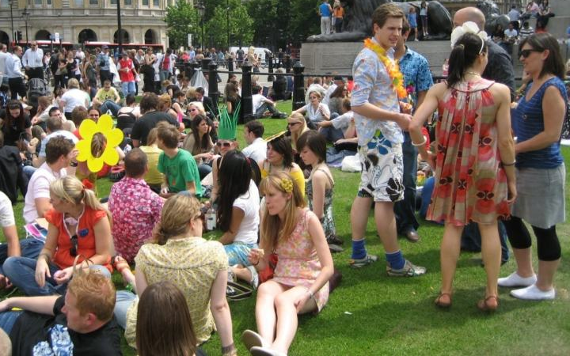
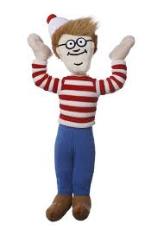
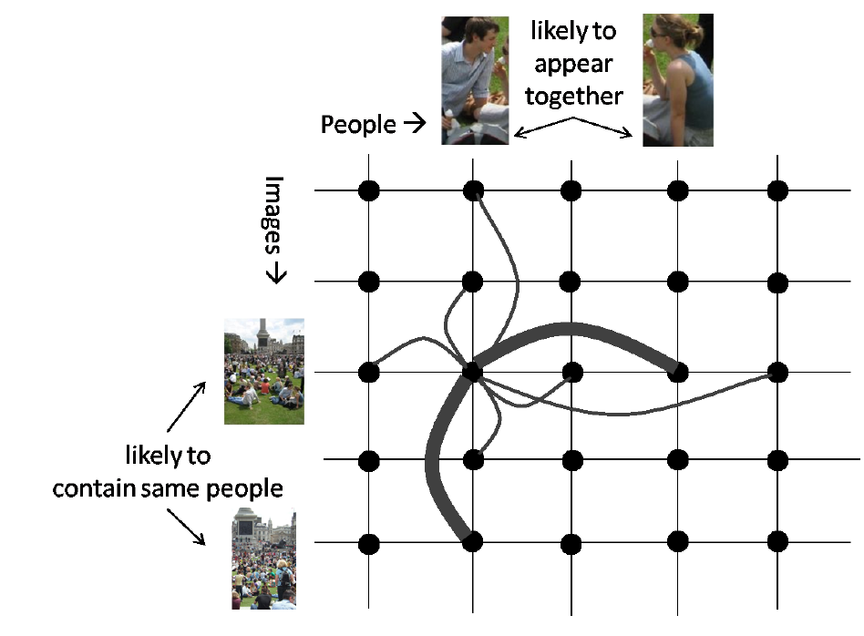
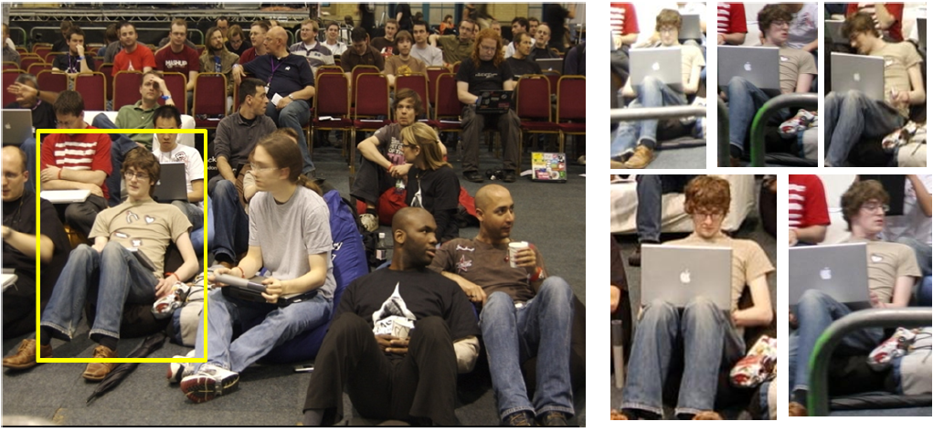
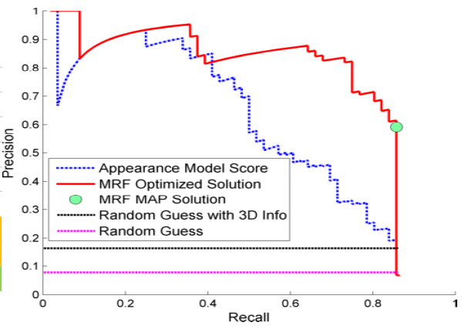
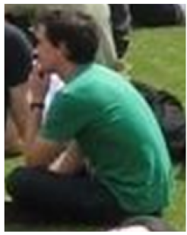
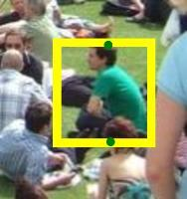
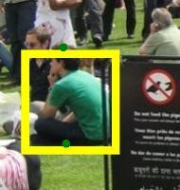
Where’s Waldo: Matching People in Images of Crowds
University of Washington
University of California, Irvine
University of Washington, Google Inc.
Cornell University
Rahul Garg Deva Ramanan Steven M. Seitz Noah Snavely
Problem Definition
Details of the Approach
Results
Given a person in a single image, find all other photos of that person from a collection of community photos of the same event.
Appearance Classifier :
All datasets downloaded from Flickr and manually matched with assistance from geometry
User Input – p_{head}, p_{ground}, masks for head, torso and legs on a single query image. Learn pixel level RGB classifier using logistic regression for the three parts
34 photos taken by a single photographer at Trafalgar Square on a single day. 16 different people to match, 130 total matches
Query Image
Dataset 1:
User input on query image
Scoring a candidate: Align the candidate with the template. Run the part classifiers and sum the pixel classification weighted using part masks
Align candidate match with query image and classify pixels part classifiers
3D Localization :
Sample matching result for one person: 7/9 matches found. The query image was a back pose while the found matches are all side poses. There are two missed matches, one with extreme pose change and the other with severe occlusion.
Camera pose from Structure from Motion
Propose candidate locations by backprojecting rays from query image. Project candidates into other images and score using learnt classfier
Matches
Results for individual people and precision recall curve showing the improvement from MRF refinement.
Query Image
Our approach finds 4 of the 5 matches shown above
Challenges
Height Prior: Prior on average height of a person
Ground Prior: Encourage backprojection of p_{ground} to be close to the ground plane in 3D
Dataset 2:
282 photos taken by 89 different photographers at Trafalgar Square on a single day. 57 people, 244 total matches.
MRF Refinement :
Non-rigid Pose Change
Severe Occlusion
Low
Resolution
Photos from hundreds of users, Different viewpoints
Choose 3D location with highest score for each person. Project into each image and decide which projections are true matches. Use co-occurrence and time cues.
Key Idea
Generalization
Of
Multi View Stereo
(MVS)
Co occurrence and Time Cues: People appear with the same group of people. Images nearby in time are likely to contain the same set of people.
A representative result: 6/7 matches found are correct. One of the missed matches has extreme occlusion and the false positive is due to presence of a similar color. Precision Recall curve on the right.
MRF Model:
Node for every person-image pair, (p_{i},I_{j}). Solve for a binary labelling where label = 1 if p_{i} occurs in I_{j}
Unary term: Appearance classifier score
Add edges between people with weights determined by people affinity, edges between images with weights determined by image affinity
Dataset 3:
45 photos from 19 different users taken during an indoor event – Hackday London 2007 over two days. 16 people, 56 matches.
Assumptions: Known camera pose, small person movement over short time interval
MVS | Waldo Problem
Photoconsistency through NCC, etc. | Appearance Consistency through a custom classifier
3D localization | 3D localization with custom priors
Smoothness in space via MRF | “Smoothness” over time and people via MRF
All 5 matches are found. Note that the laptop is not visible in the query image.
Image Affinity: where t_{i} is the corresponding time stamp
Conclusion
Learn Appearance
Classifier
People Affinity: where D_{i} is the set of images that contain p_{i}.
Solve MRF iteratively updating D_{i} each time.
Very hard problem made tractable by simplifying assumptions: Known camera pose, relatively static people
Relax assumptions in future: “track” people from photos, use stronger appearance cues in photos with unknown camera pose
Lack of datasets presently – will change with more cameras and more photo sharing
3D Localization
MRF Refinement
Single labeled instance
Matches

