Slide 1
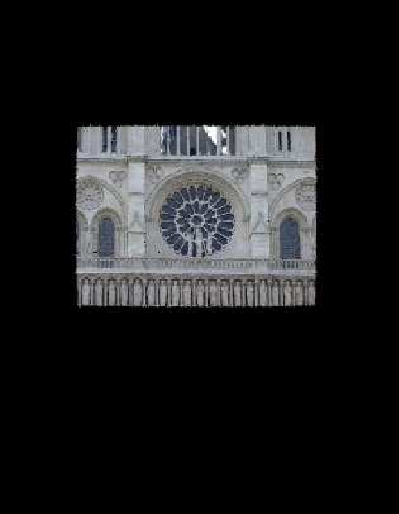
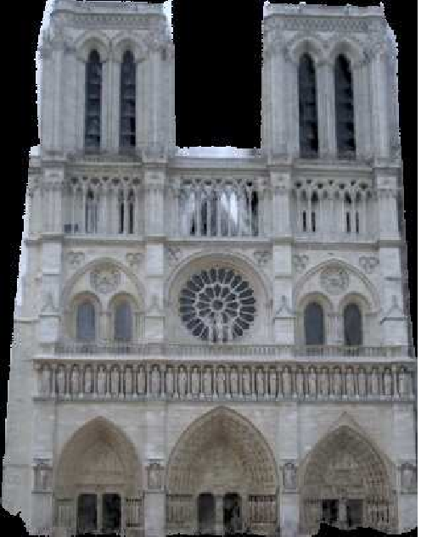
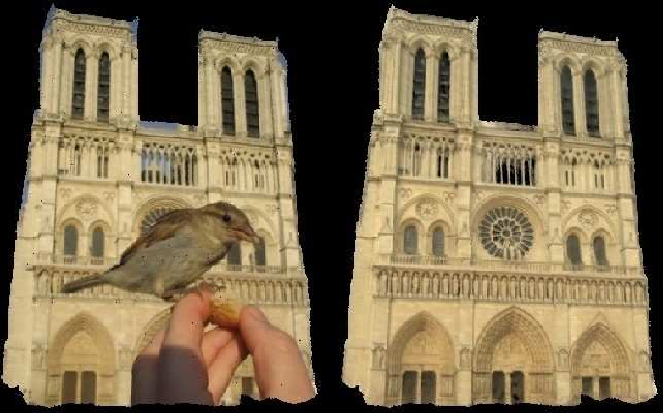
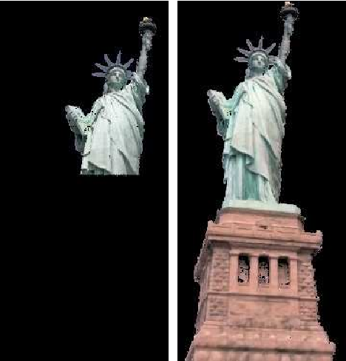
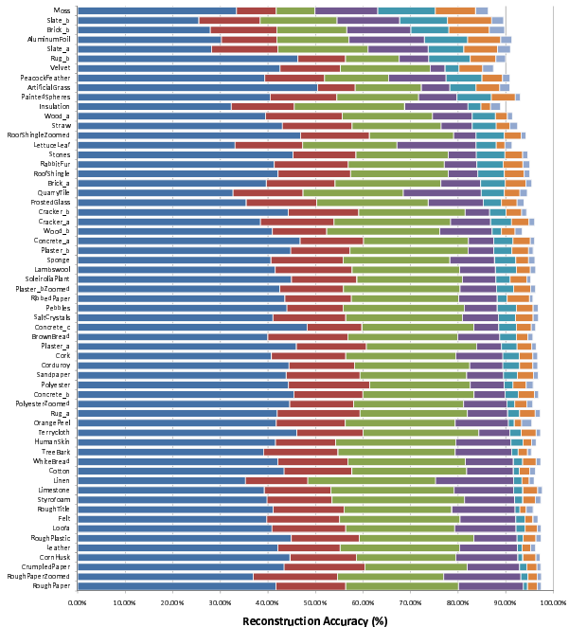
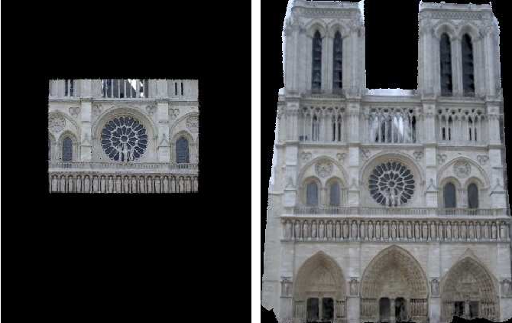
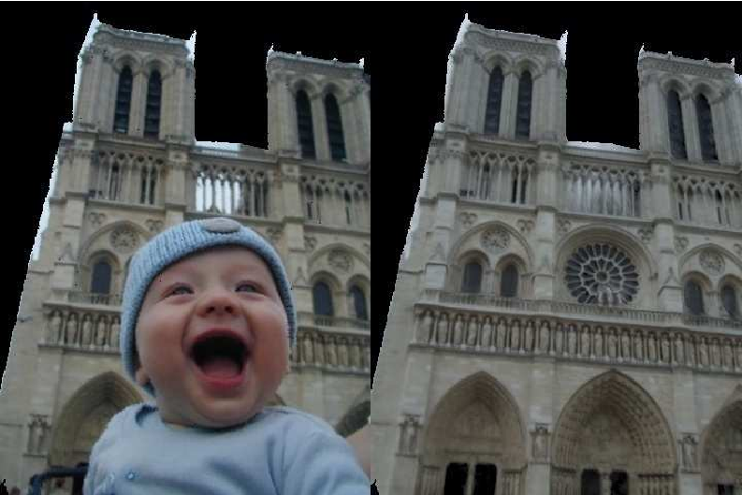
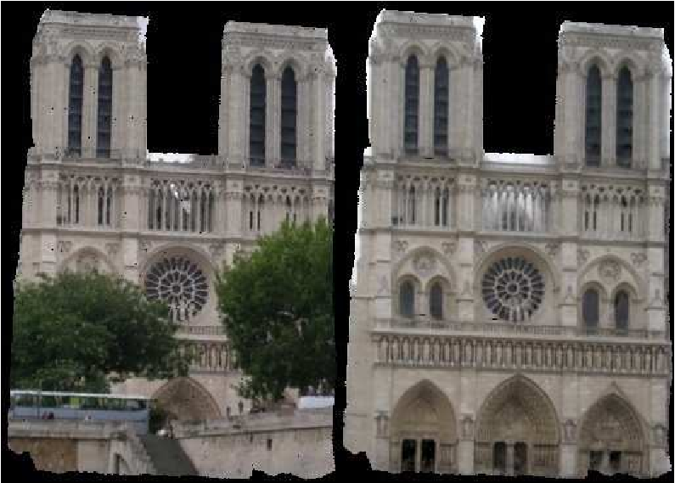
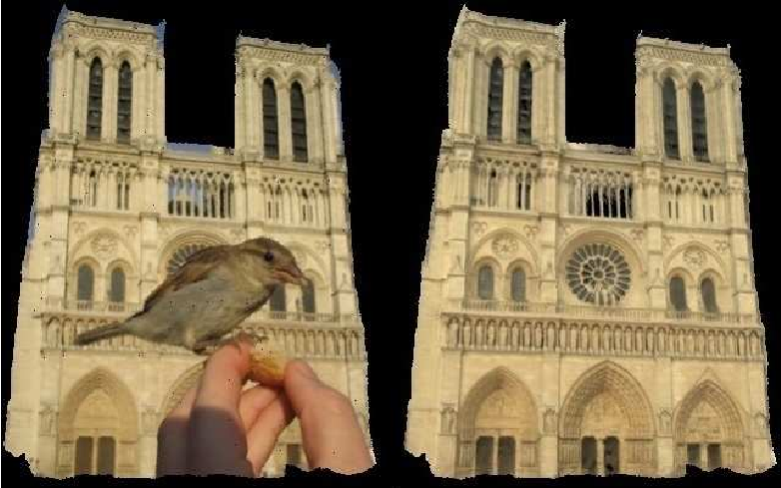
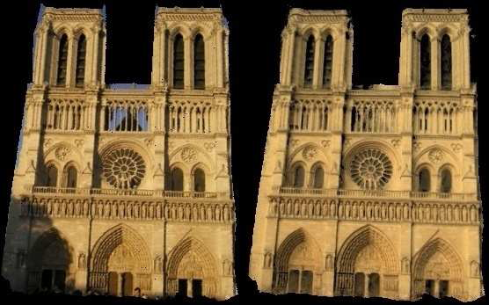
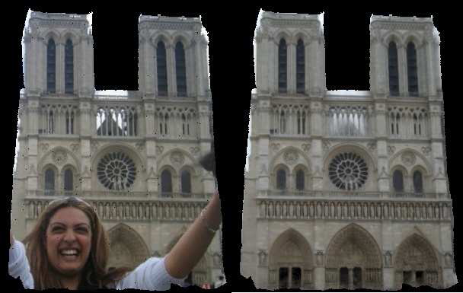
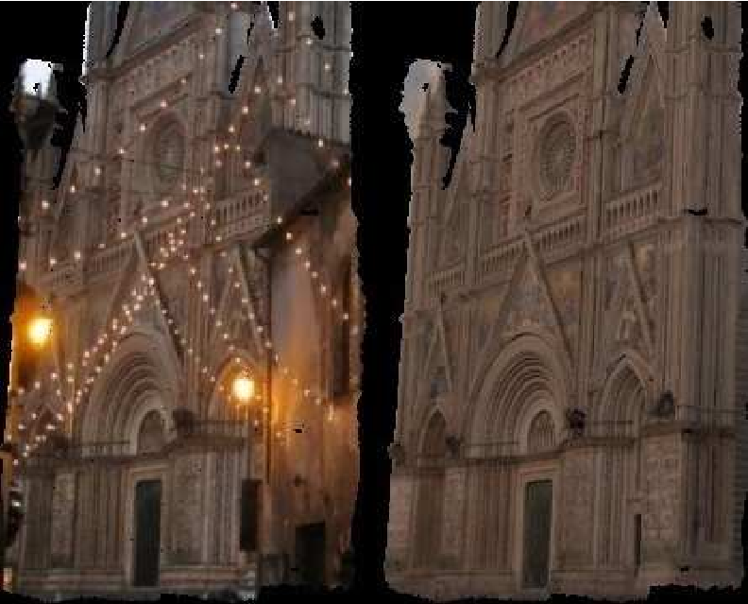
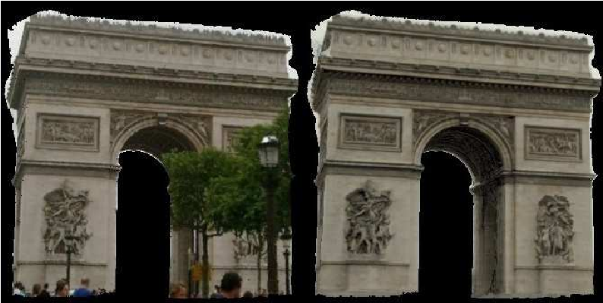
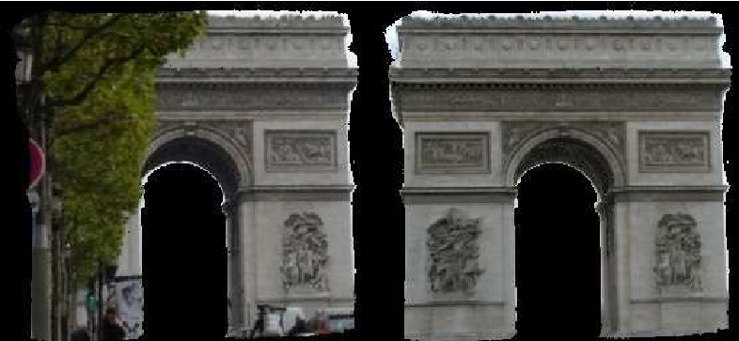
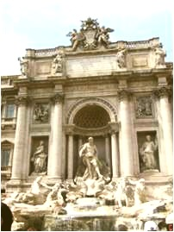
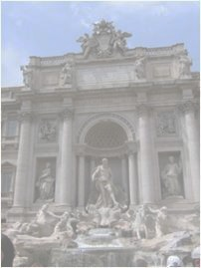
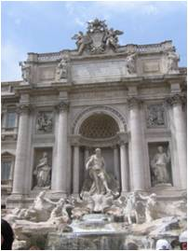
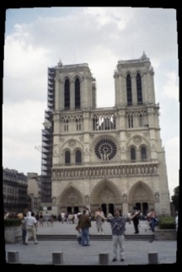
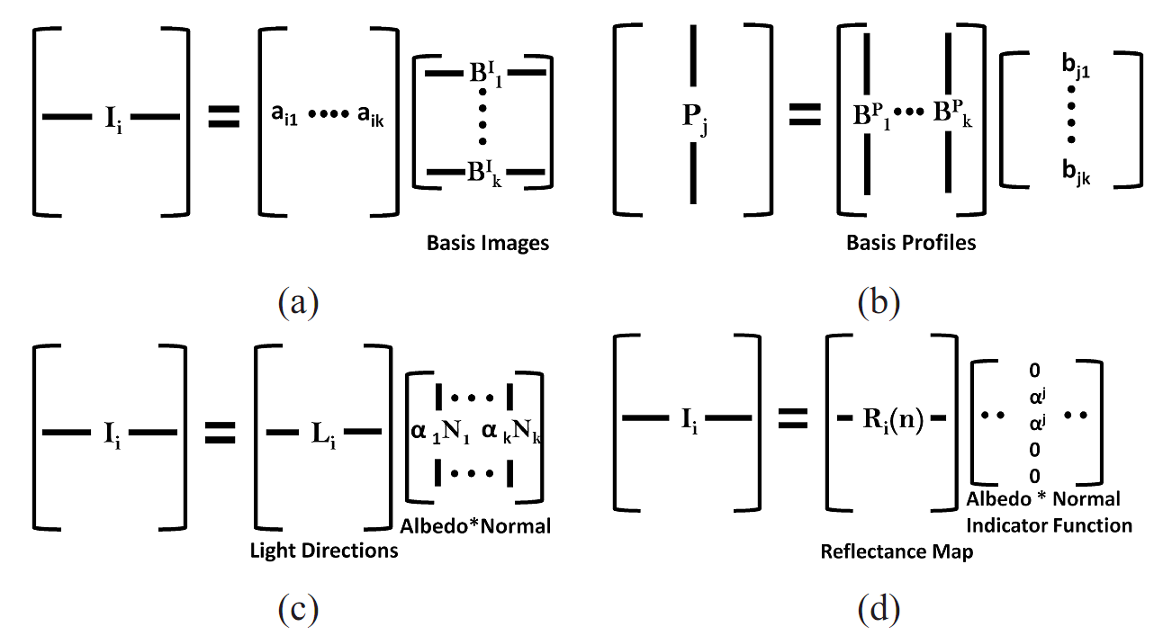
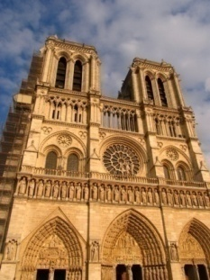
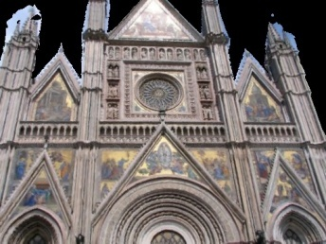
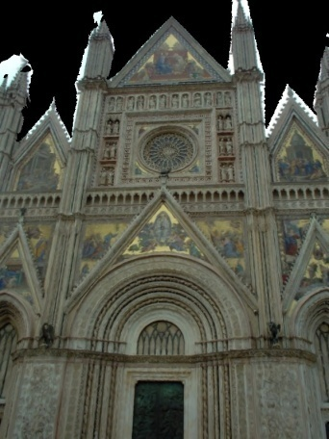
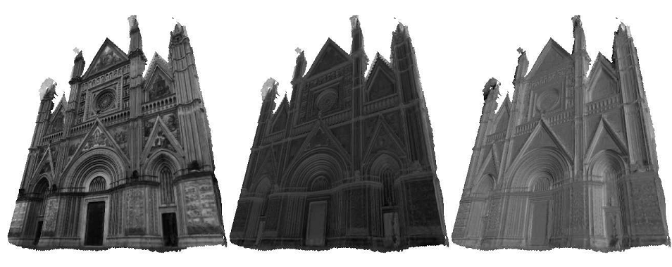
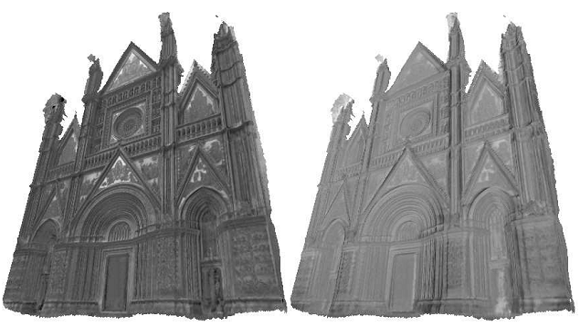
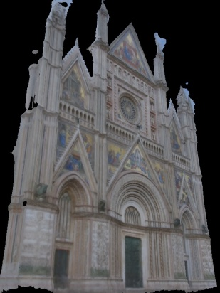
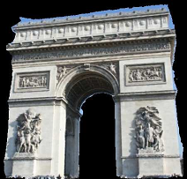
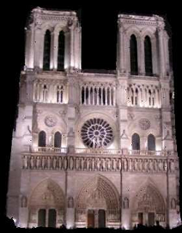
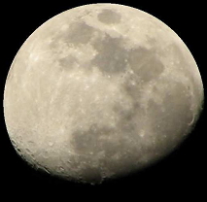
The Dimensionality of Scene Appearance
University of Washington
Cornell University
Rahul Garg, Hao Du, Steven M. Seitz and Noah Snavely
Theoretical Results
Applications
Assumptions: Distant viewer and lighting, no cast shadows.
Basic Result: From structure of D, rank(M) ≤ rank(D) ≤ # of normals
Extensions: (follow from factorizations)
View Expansion: Images cover only a part of the scene. Reconstruct the rest of the scene under similar illumination conditions.
Conditions | Dimensionality
K_{ρ} different BRDFs, K_{n} normals | K_{ρ}K_{n}
K_{ρ} dimensional family of BRDFs, K_{n} normals | K_{ρ}K_{n}
Images taken from different viewpoints, geometrically aligned | K_{ρ}K_{n}
Filtered images – filtered by K_{f} dimensional family of filters | K_{f} K_{ρ}K_{n}
K_{ρ} different BRDFs, i^{th} BRDF of dimensionality K(i) (For e.g., Lambertian is rank 3) | ΣK(i)
Introduction
View Expansion
Low rank approximation of image collections (e.g., via PCA) is a popular tool in Computer Vision. Yet, surprisingly little is known to justify the observation that images of a scene tend to be low dimensional, beyond the special case of Lambertian scenes. We consider two questions in this work:
When can we capture the variability in appearance using a linear model?
What is the linear dimensionality under different cases?
Occluder Removal: Remove the foreground objects and hallucinate the scene behind.
Previous Results
Distant Viewer | Distant Lighting | Lambertian | No Shadows | 3 basis images [Shashua’92]
Distant Viewer | Distant Lighting | Lambertian | Attached Shadows | 5 basis images [Ramamoorthi’02]
Distant Viewer | Distant Lighting | Single Arbitrary BRDF | Attached Shadows | # of normals [Belhumeur and Kriegman’98]
Real world images captured by physical sensors: Using linear response model:
Where I_{i}(x) is the intensity at pixel x, s_{i}(λ) is the sensor spectral response, and I_{i}(x, λ) is the light of wavelength λ incident on the sensor at pixel x.
BRDF as a function of λ: α(λ)ρ(ω,ώ,λ), where α(λ) is a wavelength dependent scalar (albedo).
Results:
Reconstruction accuracy for materials in CUReT database using 1,2,3,6,10 and 20 bases respectively
Factorization Framework
Matrix M contains images as rows. Consider an arbitrary factorization of M into A and B.
Four interpretations of factorization:
Rows of B as basis images.
Cols of A as basis profiles.
The Lambertian Case: When k = 3, rows of A may be thought of as light vectors while the columns of B will correspond to pixel normals (ignoring shadows).
The Reflectance Map Interpretation: Distant viewer, distant lighting, single BRDF => pixel intensity is a function of the normal alone.
R(n): Reflectance Map, can be encoded as an image of a sphere R ,of the same material and taken under similar conditions.
An image I_{i} = R_{i}^{T} * D, where D is normal-indicator matrix, i.e., D(j,k) = 1 iff normal at the k^{th} pixel of the scene is same as the normal at the j^{th} pixel of the sphere image.
= M_{mxn} =
A
B
Conditions | Dimensionality
K_{α} different albedos, K_{ρ} different BRDFS, K_{n} normals | K_{α}K_{ρ}K_{n}
ρ(ω,ώ,λ) independent of λ, light sources with same spectra, similar physical sensors | K_{ρ}K_{n}
_{k} _{x n}
Occluder Removal
_{m x n}
_{m x k}
Experiments on CUReT BRDF Database
“Profile” of a pixel
Results for Internet Photo Collections
61 different materials. Rendered 50 X 50 images of a sphere of each material under 100 different distant directional illuminations (6100 images in total). A universal basis was learned from all 6100 images to gauge the range of materials present in the database. Surprisingly, the reconstruction error when using a universal basis was not found to be very different from the case when a separate basis was learned for each material. The average RMS reconstruction accuracy was 85% using only six universal bases.
Project registered images onto 3D model. There is missing data in each observation as an image captures only a part of the scene – use EM to learn the basis appearances.
First 5 basis images for Orvieto Cathedral
The first six basis images are also shown in the image on the right, which are remarkably similar to the analytical basis images used to span the appearance space of a Lambertian sphere by Ramamoorthi’02.
Input
Images
Basis 1
Basis 2
Basis 3
Basis 4
Basis 5
First 6 basis spheres computed from CUReT database
Original
Image
Reconstruction results
1 basis
3 bases
5 bases
10 bases
20 bases
5 Analytical Lambertian basis images [Ramamoorthi’02]
Conclusion
Theoretical contributions:
Dimensionality results for multiple materials.
Extension to images taken from different viewpoints, low dimensional family of BRDFs, filtered images.
Results for images captured through physical sensors.
Experiments and applications:
Experimental results on BRDF databases (CUReT).
Modelling appearance of diverse Internet Photo Collections using low rank linear models and demonstrating applications of the same.
Light Direction
Pixel Normals
B_{3 X n}
M_{m X n}
A_{m X 3}

